Slide 1
how daily stressors impact the eating and sleeping habits of working students
By Elizabeth Plues

Slide 2
Rationale
Previous literature focusses on workers or students but does not research both simultaneously.
There is a lot of understanding regarding the stress workers and students face within environments but little regarding their daily stressors.
By utilizing a qualitative approach the current study would be more naturalistic and flexible whilst allowing focus on the objective responses and subject meaning of the data (Aspers & Corte, 2019).
The use of a focus group or interview could introduce inaccurate memory or response to what is socially desirable whilst the presence of a researcher can further impact the participant’s behaviour/response (Alamri, 2019).

Slide 3
Participants
Participant | Age | Dependents | Education | Hours Worked (Per-week)
1 | 29 | None | Part-time | 37.5
2 | 26 | 1 | Full-time | 16
3 | 20 | None | Full-time | 15-25
4 | 35 | 1 | Part-time | 24
5 | 26 | None | Full-time | 14
6 | 22 | None | Full-time | 25
7 | 26 | None | Full-time | 30
8 | 21 | None | Full-time | 19
9 | 20 | None | Part-time | 48
10 | 20 | None | Full-time | 16
11 | 28 | None | Part-time | 35
12 | 26 | None | Part-time | 16
13 | 28 | None | Part-time | 40
14 | 21 | None | Full-time | 20
Table 1 Displays Information Provided by Participants.

Slide 4
methodology
The solicited diary was split into three main segments to assess habits: sleep, food/drink, and academic/workday with a section at the end to reflect.
Each of the diaries were thematically analysed following the six-step guide provided by Braun and Clarke (2006).

Slide 5
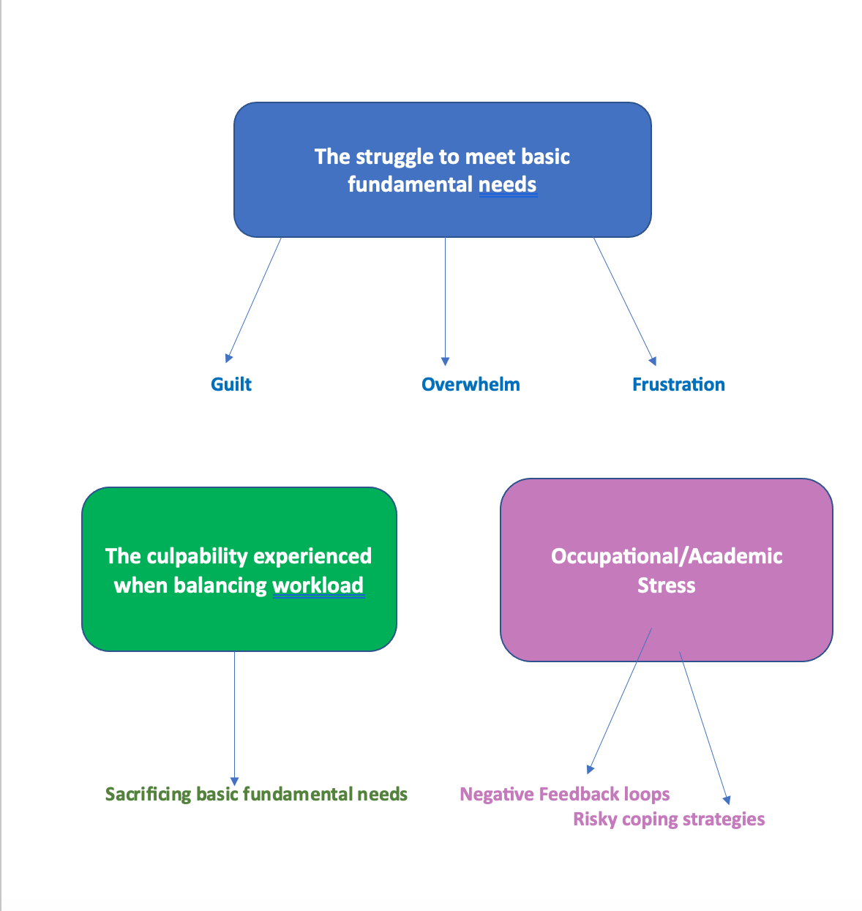
Results

Slide 6
Discussion
Lecturer’s communication often leaves students feeling overwhelmed, confused, and anxious about their coursework.
Delivering lectures/assessments in a user-friendly manner and introducing interactive learning can better a students’ experience, well-being, and reduce feelings of anxiety and overwhelm (Baik et al., (2019).
Furthermore there is a clear indication that access needs to be enhanced and barriers removed for student services by raising more awareness of the support available and ensuring that these facilities are well equipped to support the increase in demand (Baik et al., (2019).

Slide 7
Conclusion
The aim of this study was to provide working students with a platform and opportunity to disclose the daily stressors they face and how these impact their eating and sleeping habits.
Furthermore, the study aimed to understand working students’ experiences and highlight where support could be improved.
The current study achieved the above and bridges the gap between existing literature and the understanding of how daily stressors impact the eating and sleeping habits of working students.

Slide 8
Thank you

